Slide 1
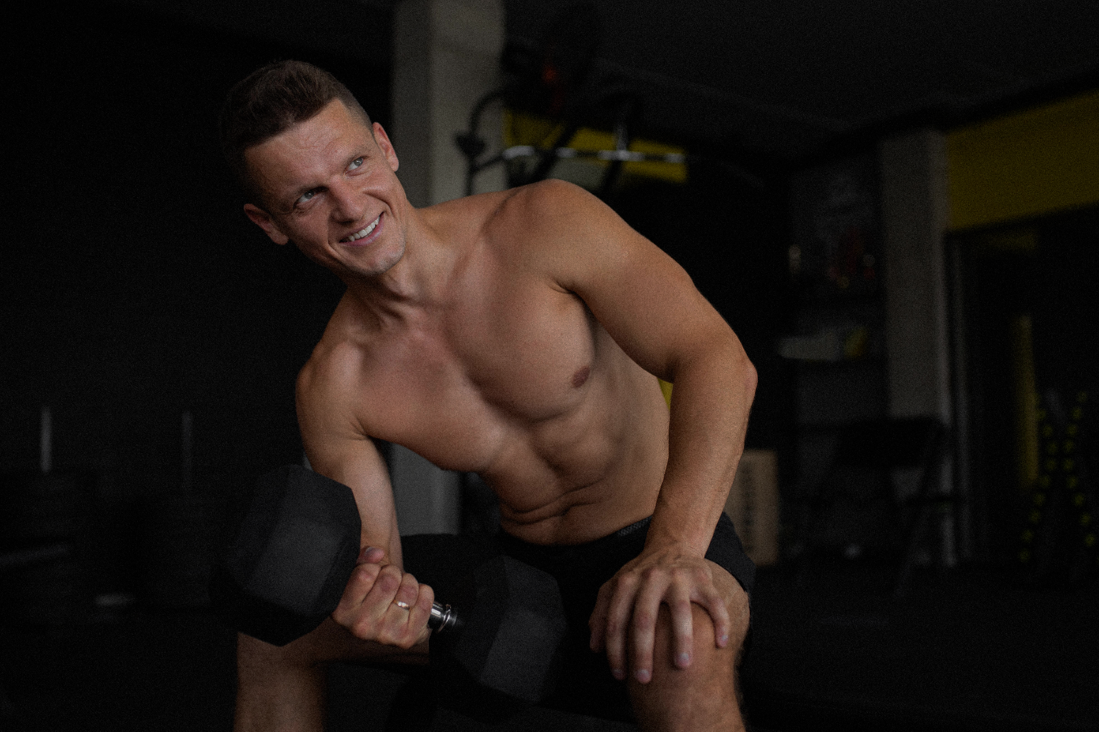
Smart Gym Trainer
Name: Mazen Tarek ID: 200259

Slide 2
TABLE OF CONTENTS
01
02
Problem statement
Methodology
03
04
Project Stages
What is the problem that we are facing?
What can I do to solve this problem?
Related work
What other people have done regarding this topic?
How the program runs?
05
06
Results
What were the findings of the study?
Conclusion & Future work
What did I accomplish and what lies ahead of me?

Slide 3
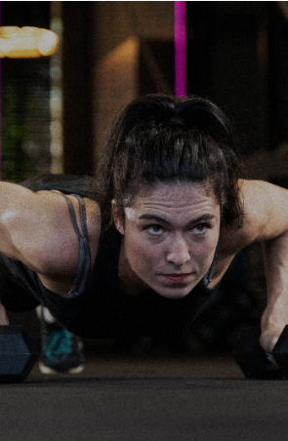
Problem statment
Regular exercise is crucial for good health and fitness, which can be accomplished by going to a gym. However, it's important to keep in mind that improper execution of exercises can lead to injuries, some of which may go unnoticed.

Slide 4
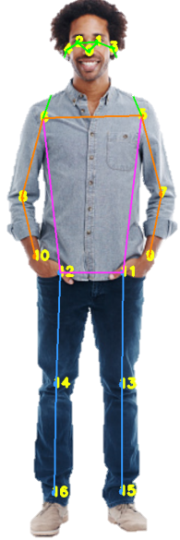
Methodology!
The objective of this project is to create a suitable workout plan that includes three essential stages: feature extraction, angle calculation using the arctan2 method, and distance measurement using the Euclidean concept. Moreover, the user will receive an audio feedback, narrated by voice-over script, informing them of their performance.

Slide 5
USED TOOLS
POSE ESTIMATION
Python
YOLOv7
COCO
Is a high-level programing language, easy to learn, read and write.
An object detection algorithim that uses PyTorch as its base for coding.
A large-scale object detection, segmentation and captioning dataset

Slide 6
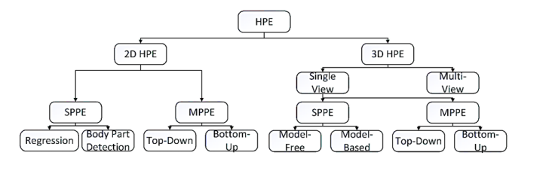
Classification of 2D and 3D Human Pose Estimations

Slide 7
RELATED WORK
MOTION TRACKING
HUMAN POSE ESTIMATION
YOGA POSES TRAINER
Microsoft utilizes 3D HPE to monitor the movement of the human players and convert it, to display digitally in the game world.
An AI-based technology assists in recognizing yoga poses and offer users feedback or recommendations.
Many papers have discussed the differences between different body modeling which are kinematic, Planer Volumetric.

Slide 8
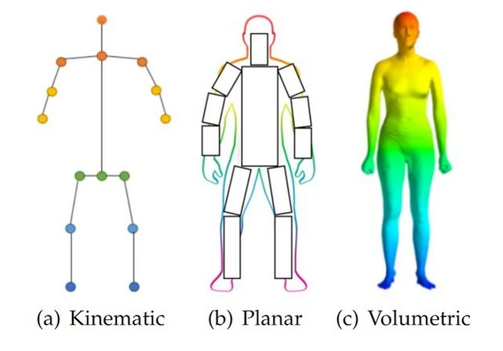
MODELS FOR HUMAN MODELING

Slide 9
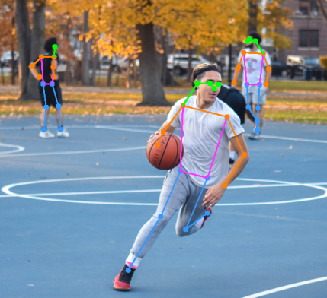
What is YOLOv7!

Slide 10
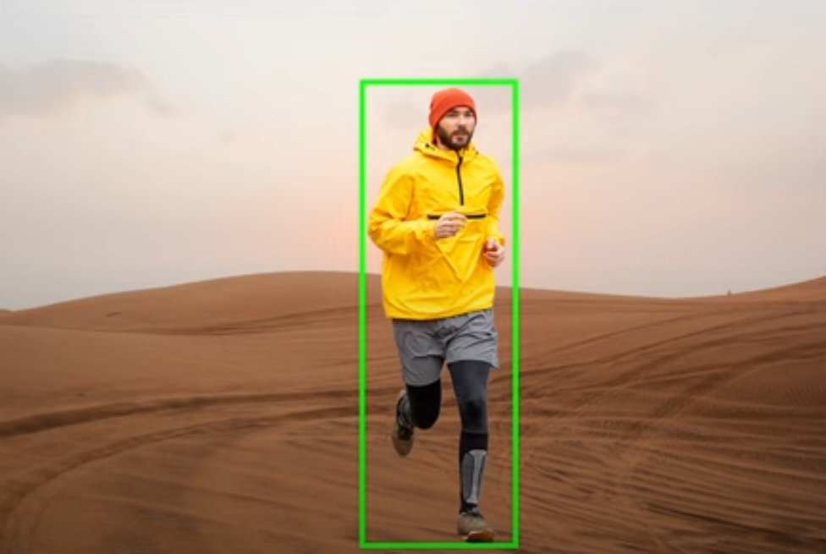
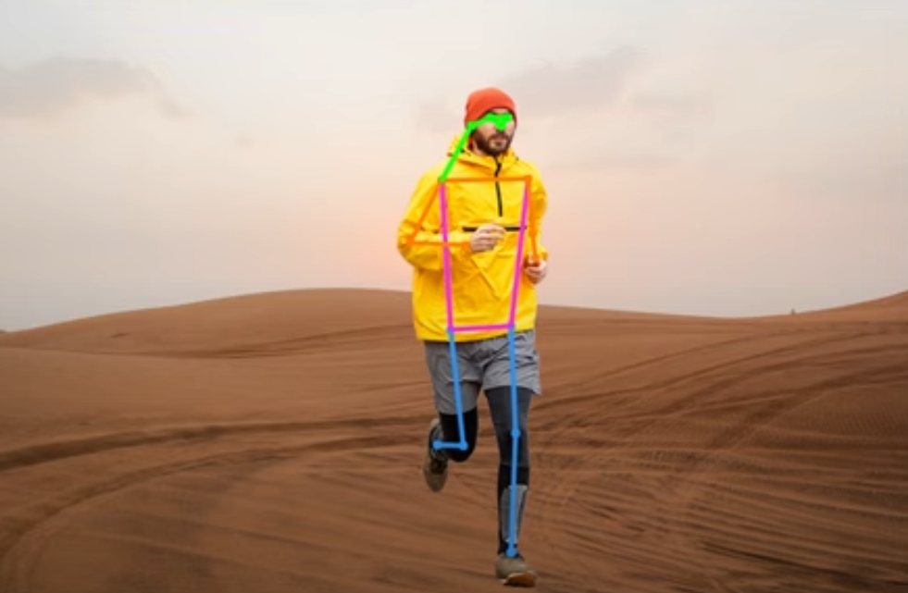

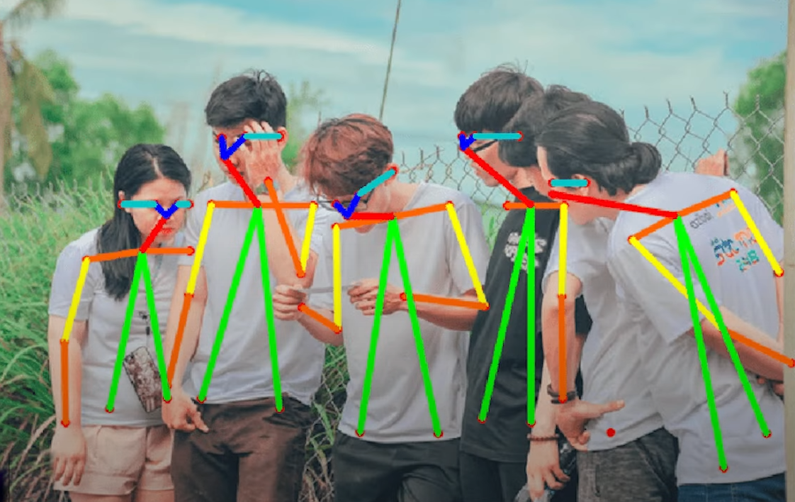
Top-Down VS Bottom-Up
Top-Down method involves detecting individuals in the image and then locating their key-points using these bounding boxes. While it can yield an accurate outcome, it might become sluggish when there are multiple people in the frame.
the Bottom-Up approach uses heat maps to find key-points, then uses grouping algorithm to map the key-points for every person. As it is a single stage, so it is fast, but it won’t be very accurate in case of crowded scenes.
---------------------------------

Slide 11
PROJECT STAGES!
Extract human key-points.
Calculate distance between key-points to count reps.
STEP 2
STEP 4
3
4
5
1
2
3
STEP 3
STEP 5
STEP 1
STEP 3
Get video of the trainee doing the exercise.
Calculate distance between specific key-points.
Encoarage the traniee by giving him feedbacks

Slide 12
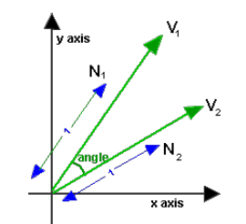
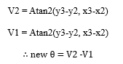
Atan2 Equation
For each key-point we extract from the frame has its unique number. Which is consists of (x, y).
The Atan2 equation output is the angle between the x-axis and the vector.
The equation is applied to both vectors that need to be calculated.
After we have calculated the angle between both vectors in radian, I have converted it into degrees for better representation.
By using Atan2, we can calculate angles between key-points to count trainee reps.

Slide 13
POSE ESTIMATION LANDMARKS

Slide 14
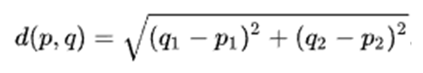
Euclidean Theorem
Euclidean theorem has been used to calculate the distance between two key-points.
Each extracted key-point from the frame has a unique number represented by (x, y).
Through application of the Euclidean Theorem, I verify that the trainee is adhering to the prescribed guidelines.

Slide 15
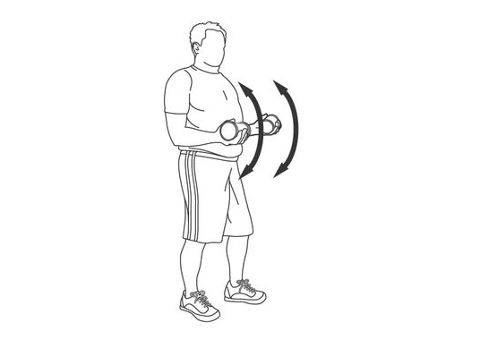
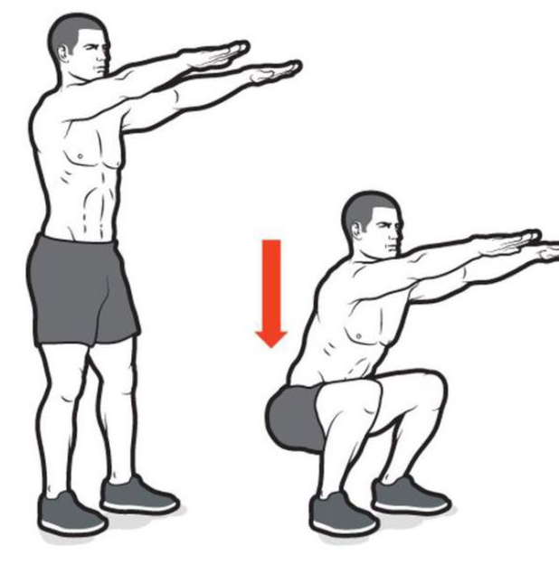
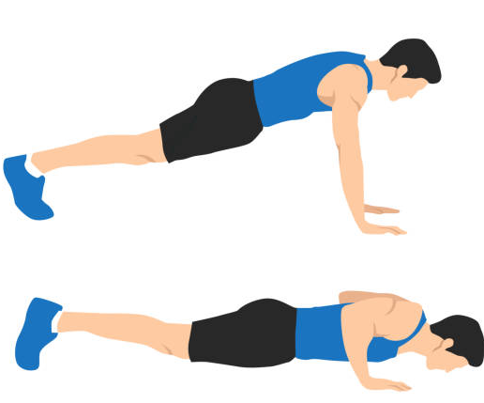
Results
Biceps Curl exercise
Proper form
Improper form
Squats exercise
Proper form
Improper form
Push up exercise
Why it is Hard to Implement Push Up Exercise using YOLOv7?

Slide 16
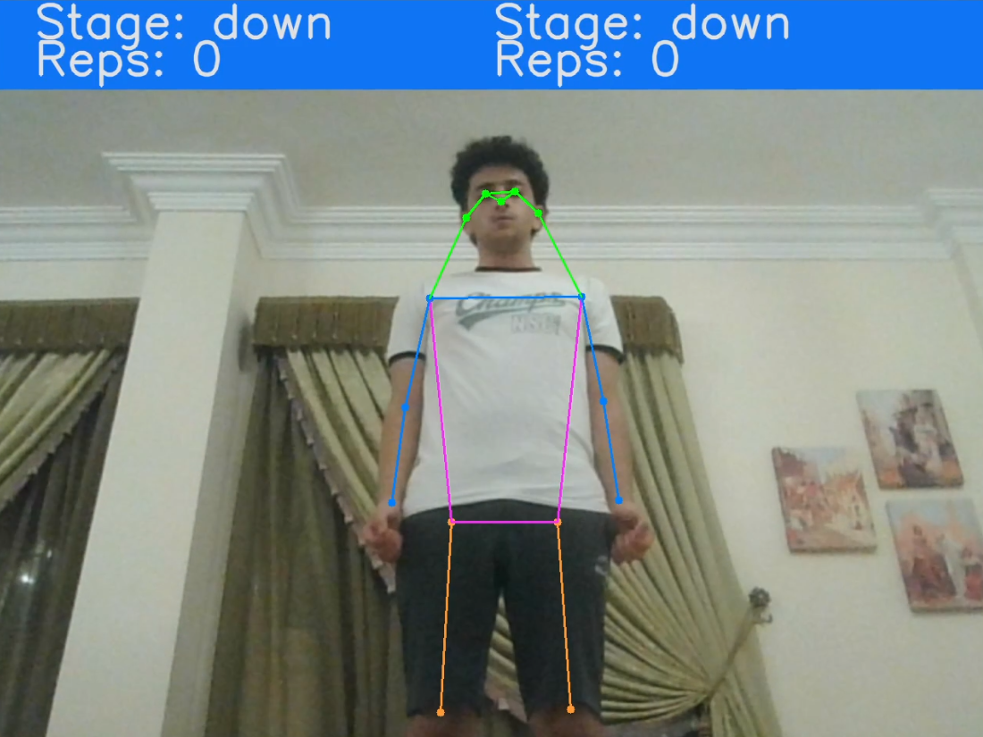
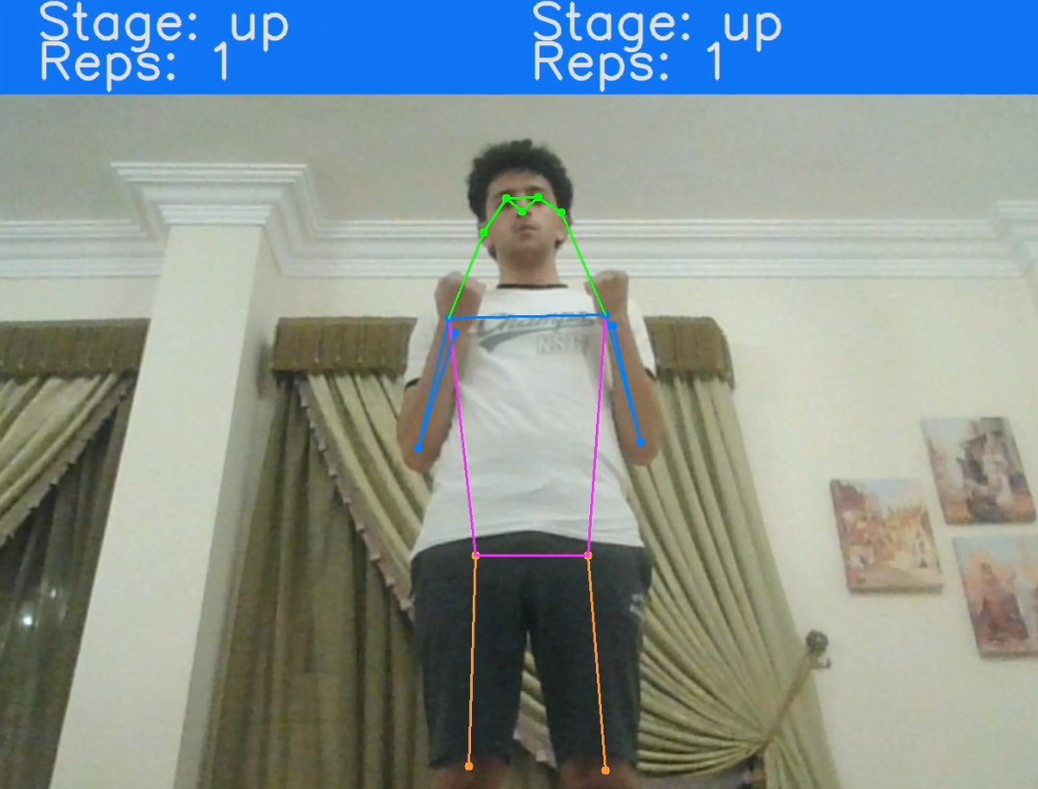
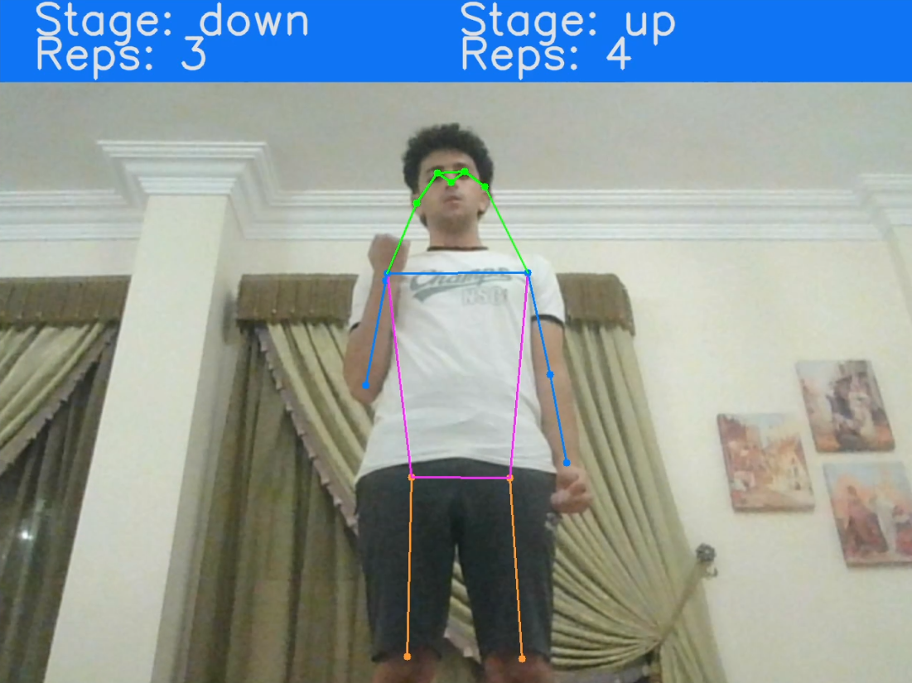
Biceps Proper form
This explains how to perform the exercise properly with a 180-degree arm position and a required ROM. The wrist distance should be equal to or wider than the shoulder distance. After completing 10 counts, a message appears congratulating the trainee.

Slide 17
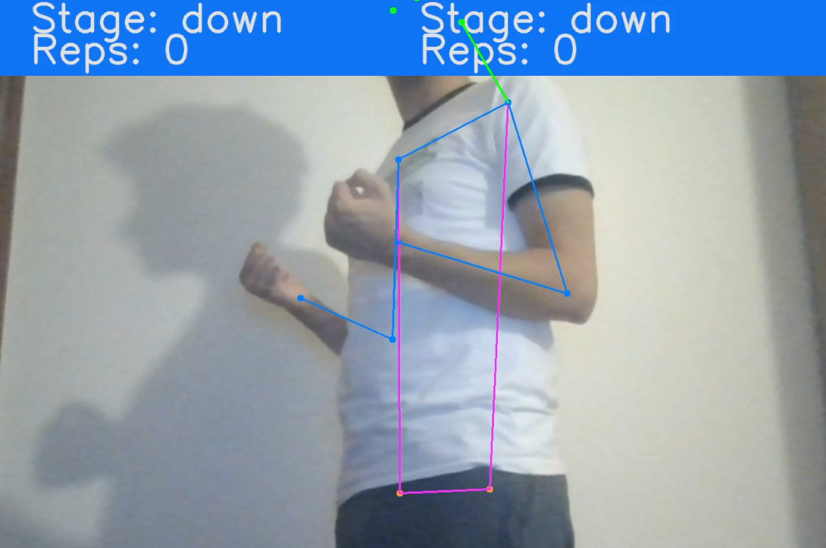
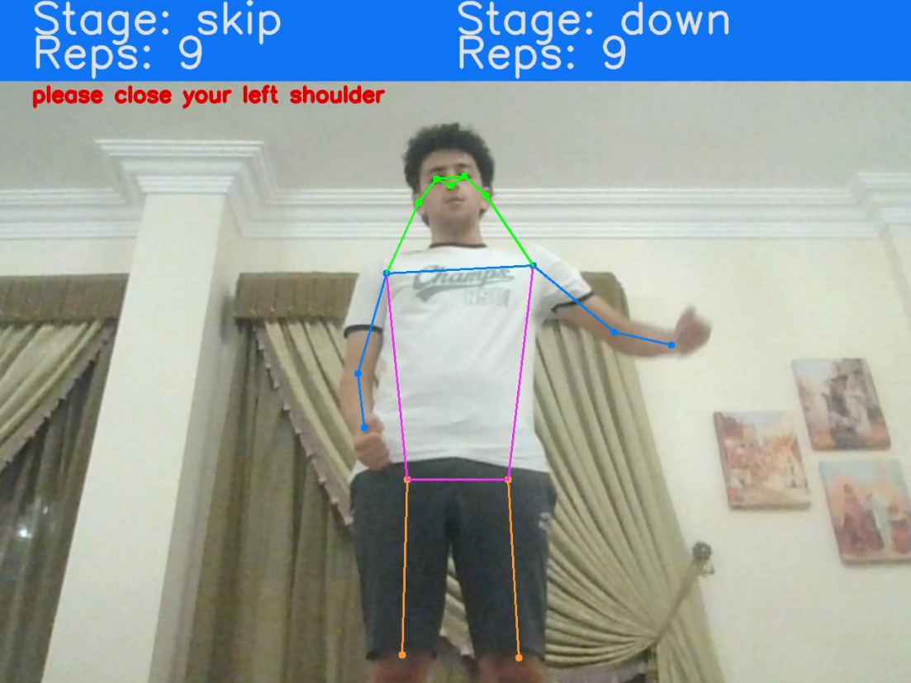
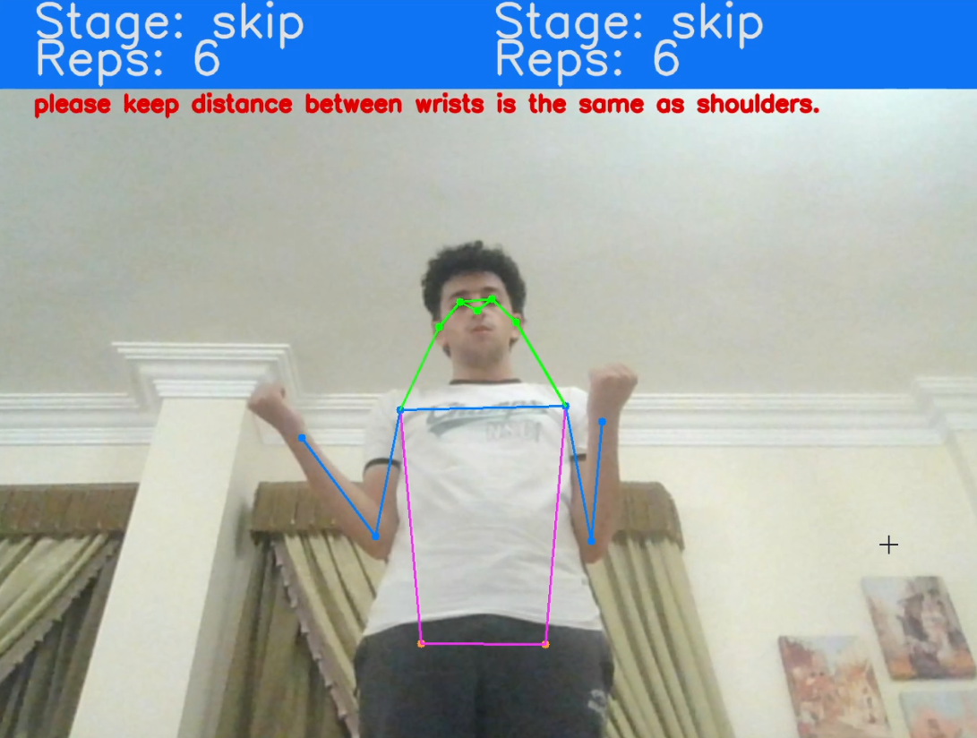
Cutting ROM
Exceeding Shoulder Angle Threshold
Ensure Distance Between Wrists
---------------------------------
---------------------------------

Slide 18
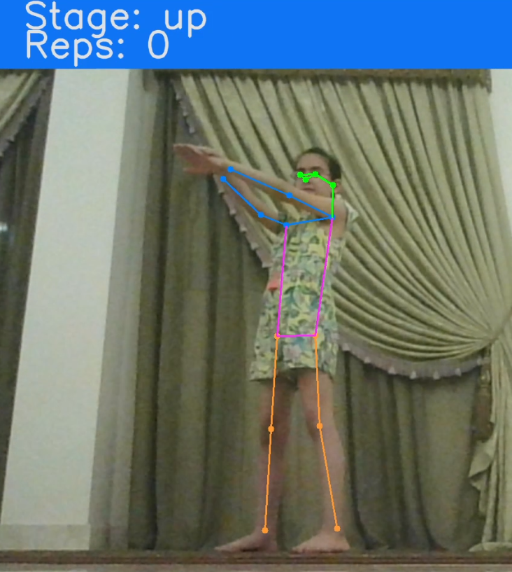
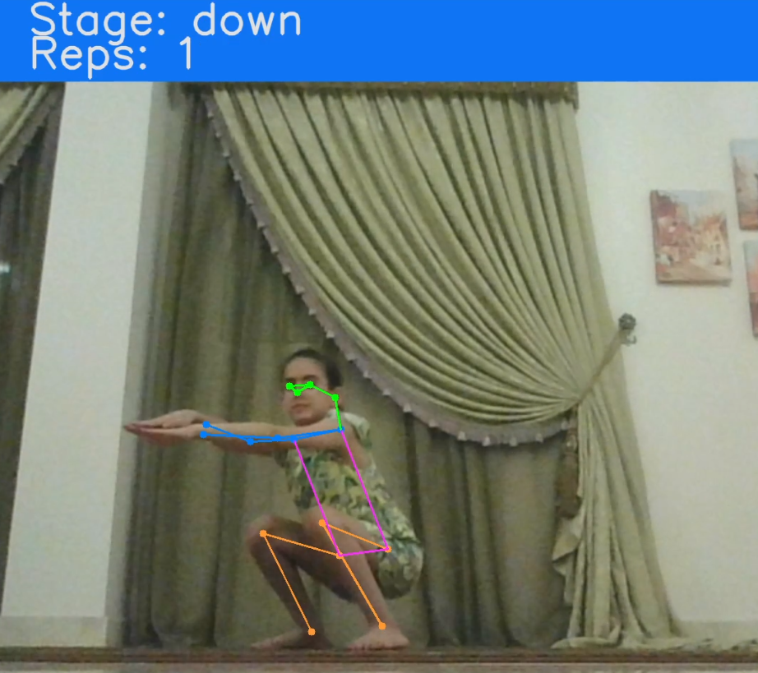
Squats Proper Form
Squats workout targets leg strength. Starting from standing up position with 180-degree knee and hip angle, the exercise begins counting when knees and hips are bent until the buttocks pass parallel to the ground.

Slide 19
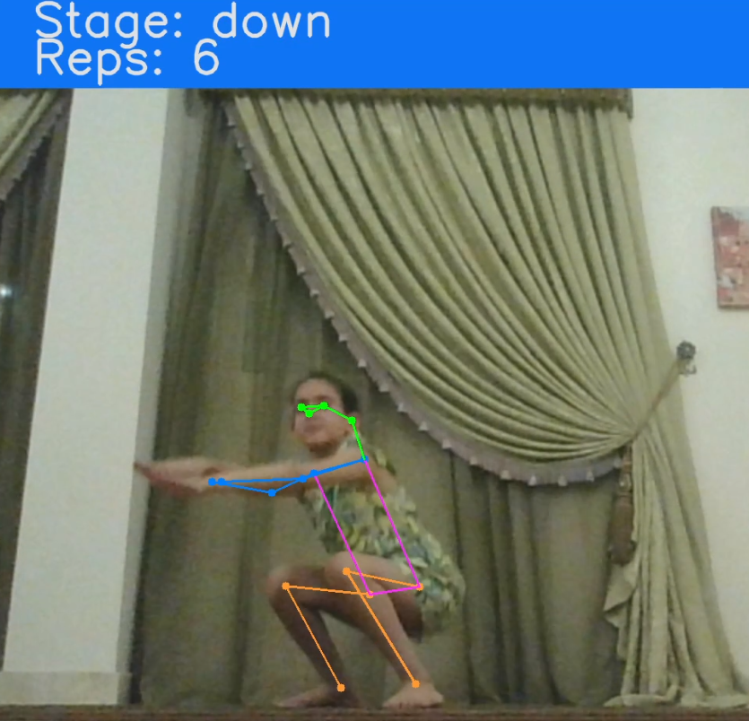
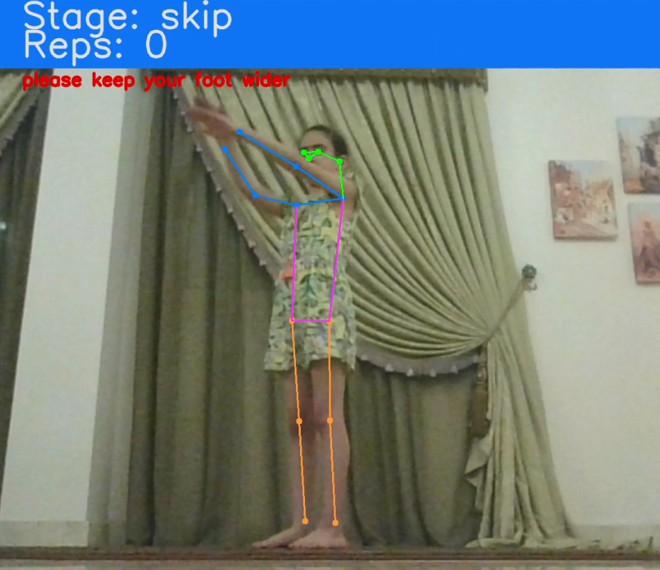
Cutting ROM
Ensure Distance Between Ankles
---------------------------------

Slide 20
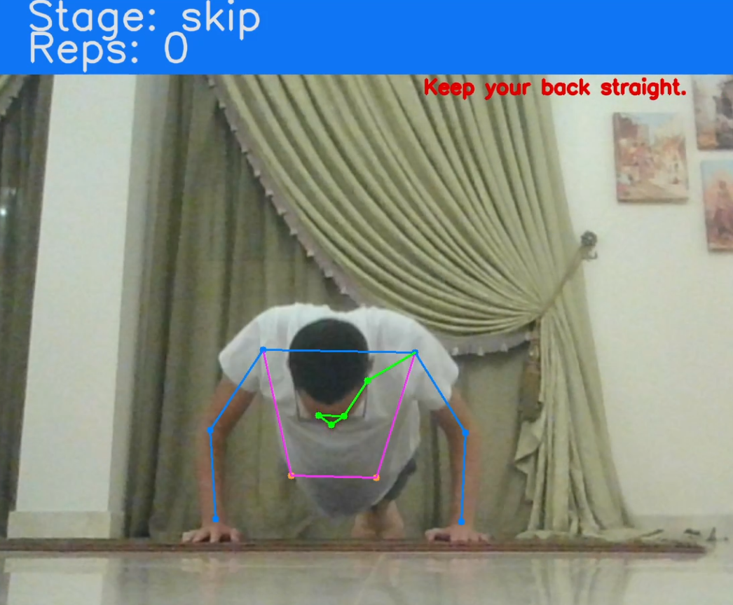
Why it is hard to implement push up?
Complication
To properly detect body parts during push up exercises using YOLOv7, two solutions are possible: using an algorithm that utilizes 3D to extract key-points accurately or using multiple cameras to capture vectors perpendicular to the body.

Slide 21
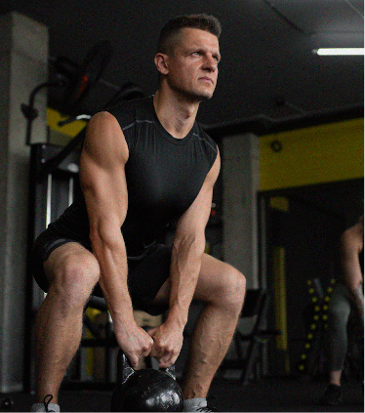
Conclusion & Future Work!

Slide 22
THANK YOU, ANY QUESTIONS!

Slide 23
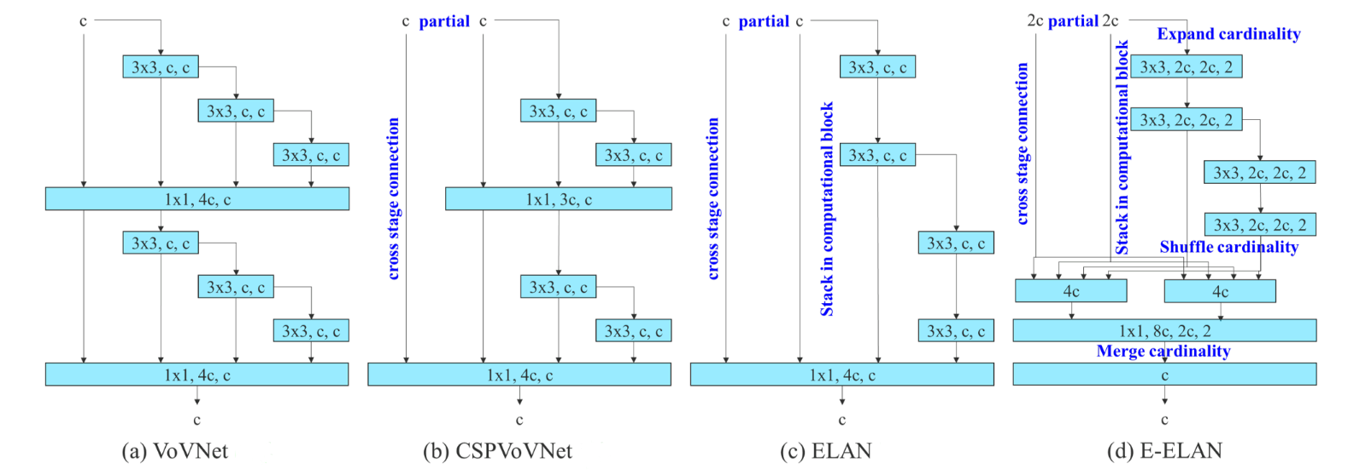
Extended Efficient Layer Aggregation Network (E-ELAN)
Notes:
YOLOv7 is the latest model in the YOLO family for object detection.
It uses the E-ELAN module to improve feature learning and parameter utilization.
E-ELAN builds upon the concept of ELAN and introduces new techniques like group convolution, shuffle, and merge cardinality.
These techniques enable the combination of features at different scales and improve model learning ability.
E-ELAN in YOLOv7 results in state-of-the-art performance in speed and accuracy compared to other real-time object detectors.
YOLOv7 is suitable for multiple applications, including autonomous driving, security, smart cities, retail analytics, manufacturing, and healthcare.

Slide 24
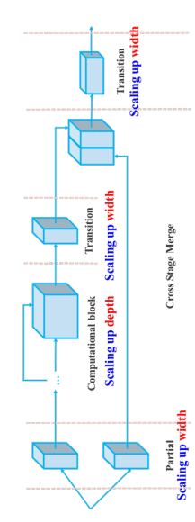
Model Scaling for Concatenation-Based Models
Notes:
• Model Scaling in YOLOv7 deals with challenges in concatenation-based models for object detection.
• Bag-of-freebies techniques and Extended Efficient Layer Aggregation Networks (E-ELAN) are used in YOLOv7 to improve object detection accuracy without increasing inference cost.
• Model Scaling in YOLOv7 involves adjusting hyperparameters such as resolution, depth, width, and stage of the model to maintain an optimal balance of performance and efficiency while considering computational cost (FLOPs) and memory requirements.
• Different models are analyzed to understand the impact of model scaling on efficiency, and techniques such as reducing FLOPs, minimizing memory access and congestion, and adjusting input/output channel sizes are employed to optimize the network structure.
• The objective of Model Scaling in YOLOv7 is to achieve state-of-the-art performance in real-time object detection, surpassing other object detection models in terms of both speed and accuracy.

Slide 25
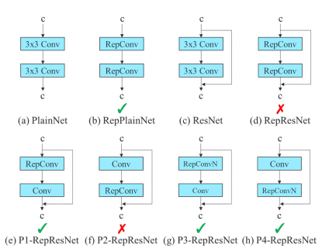
Planned Re-Parametrization Convolution
Notes:
Re-parameterization techniques involve averaging a set of model weights to create a model that is more robust to general patterns that it is trying to model. In research, there has been a recent focus on module level re-parameterization where piece of the network have their own re-parameterization strategies.
The YOLOv7 authors use gradient flow propagation paths to see which modules in the network should use re-parameterization strategies and which should not.
Website:

Slide 26
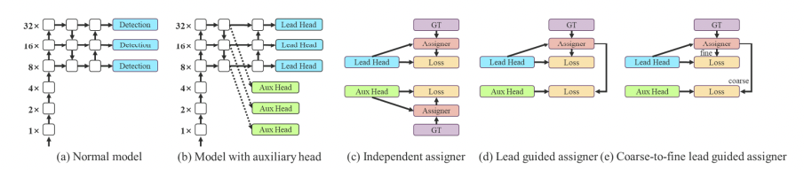
Coarse for Auxiliary and Fine for Lead Loss
Notes:
The YOLO network head makes the final predictions for the network, but since it is so far downstream in the network, it can be advantageous to add an auxiliary head to the network that lies somewhere in the middle. While you are training, you are supervising this detection head as well as the head that is actually going to make predictions.
The auxiliary head does not train as efficiently as the final head because there is less network between it an the prediction - so the YOLOv7 authors experiment with different levels of supervision for this head, settling on a coarse-to-fine definition where supervision is passed back from the lead head at different granularities.
Deep Supervision, a technique used by DL models, uses multiple heads. In YOLOv7, the head responsible for final output is called the Lead Head. And the head used to assist training in the middle layers is called the Auxiliary Head.
With the help of an assistant loss, the weights of the auxiliary heads are updated. It allows for Deep Supervision, and the model learns better. These concepts are closely coupled with the Lead Head and the Label Assigner.
The Lead Head in the YOLOv7 network predicts the final results. Soft labels are generated based on these final results. The important part is that the loss is calculated for both the lead head and the auxiliary head based on the same soft labels that are generated. Ultimately, both heads get trained using the soft labels. This is shown in the left image in the above figure.
A fine label to train the lead head
A set of coarse labels to train the auxiliary head.

Slide 27
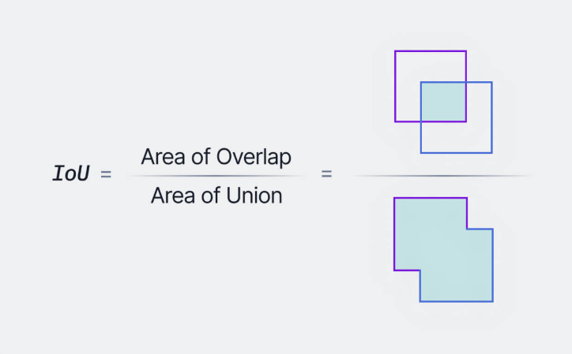
Notes:
The YOLOv7 authors sought to set the state of the art in object detection by creating a network architecture that would predict bounding boxes more accurately than its peers at similar inference speeds.

Slide 28
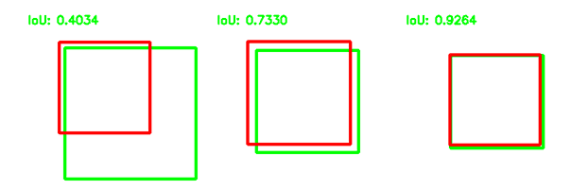

Slide 29
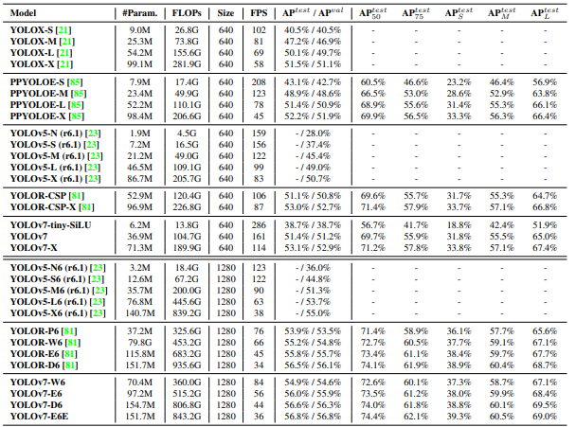

Slide 30
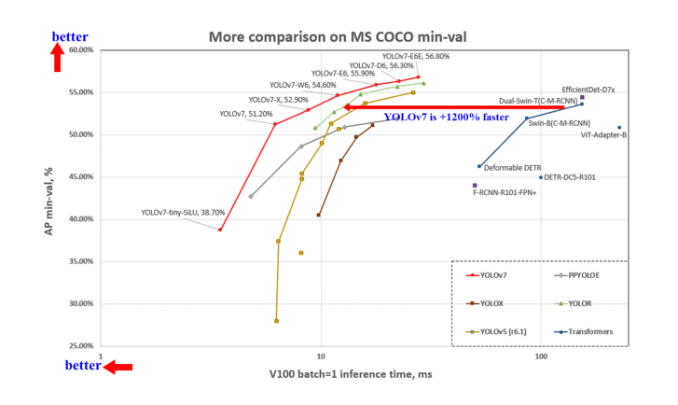
Notes:
The YOLOv7 authors sought to set the state of the art in object detection by creating a network architecture that would predict bounding boxes more accurately than its peers at similar inference speeds.

